Slide 1
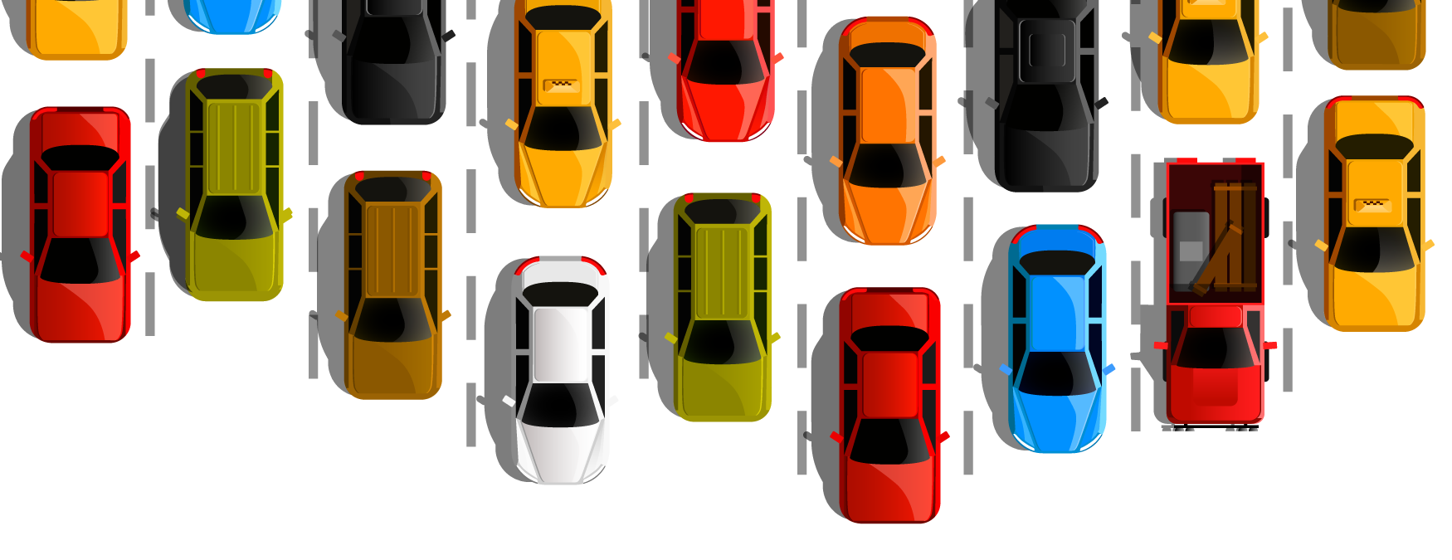
Pre Owned Cars
on the US market
Notes:
http://sjsudatabusters.com.s3-website-us-west-1.amazonaws.com
Good evening everyone, my name is Michele and here are my teammates Nivedha, Purnima and Praveen.
Today we will be exploring a dataset regarding used cars on the US market between 1915 and 2020.

Slide 2
Objectives
Clean and normalize the data
Store the data on the cloud
Analyze the data and generate insights
Notes:
Michele:
The purpose of this project is to study a dataset for used cars in the United States, by setting up a normalization process of the data, store it adequately on the cloud and finally analyze that dataset by pinpointing and understanding the factors that play a significant role in the variation of prices between the used cars.

Slide 3
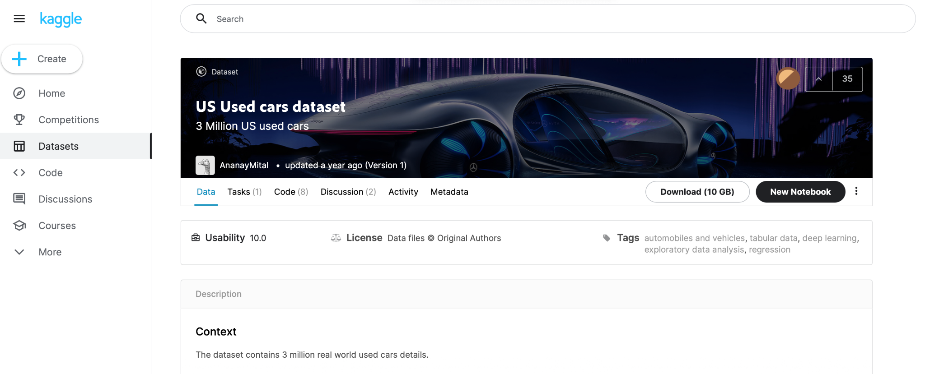
About the Dataset
Found on Kaggle
Data retrieved from Craigslist
Over 3 million rows
Notes:
Michele:
So, a little bit more about our dataset:
The dataset is found on Kaggle as part of a scraping project. the dataset includes every pre owned vehicle posted for sale on Craigslist and present on the US territory
At the time of retrieval, the dataset had a little over 3 million entries and contained all the relevant information and characteristics of the postings that Craigslist provides. That includes attributes like price, condition, manufacturer, latitude/longitude, along 18 other categories. The total number of columns were 26.
++ location table with the zip codes

Slide 4
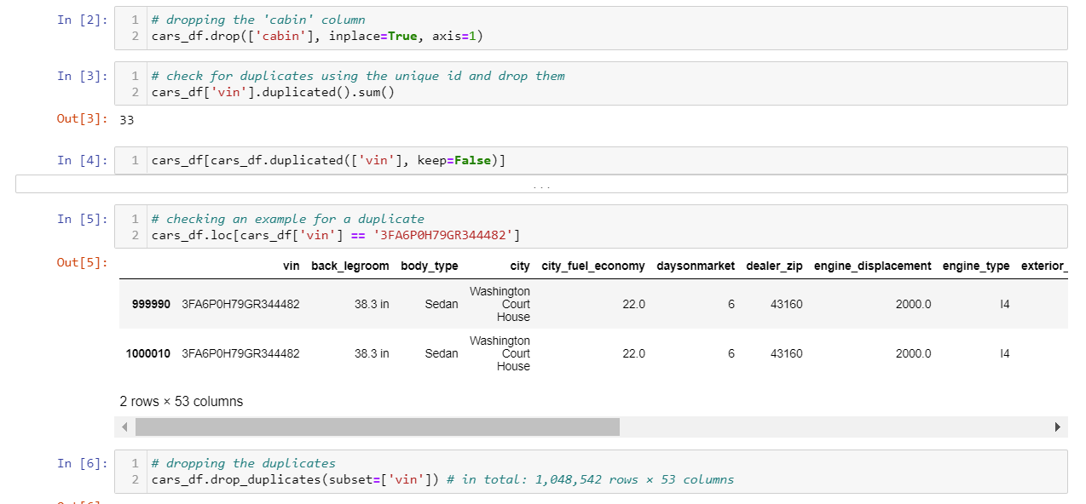
Data Cleaning
Steps carried out to clean and wrangle the dataset:
Removing bad rows: From 3 million records to ~ 1 million
Deleting duplicate car IDs
Dropping irrelevant columns to our analysis
Notes:
Michele
First, We carried out a series of steps to clean and wrangle the data, to transform it to an adequate form, capable of being stored in a SQL database
A lot of bad rows had sets of null attributes which were impossible to fill so we decided to drop them
We found out that there were a couple of duplicates using their IDs so we removed these rows
After that, we dropped columns that wouldn’t be valuable for our analysis for this project, such as a column containing images about the respective used car. That reduced the size of our dataset tremendously.

Slide 5
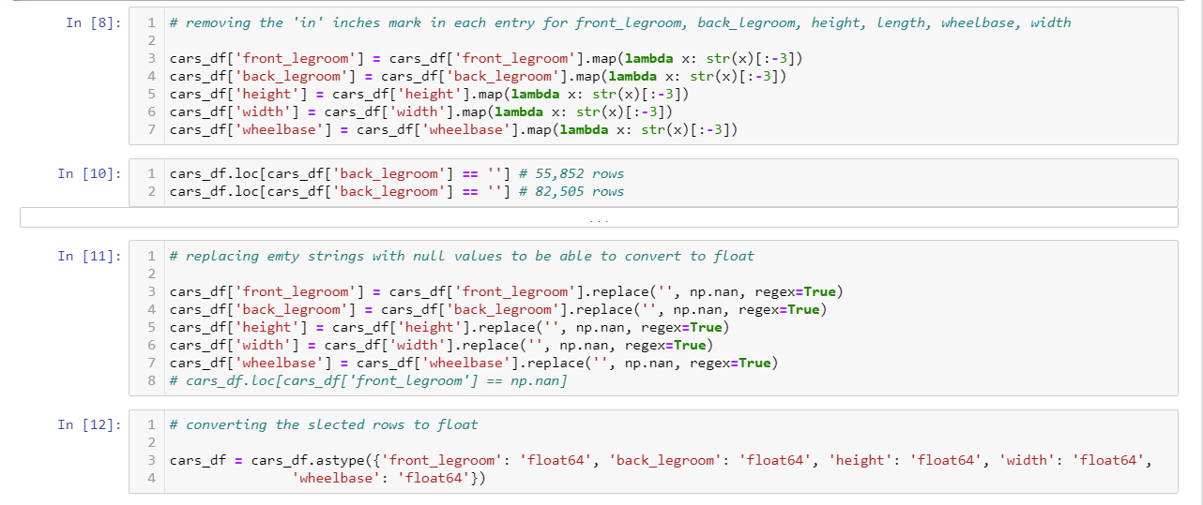
Data Cleaning, contd.
4. Transforming data from text to float
Notes:
Michele:
Some columns such as height, length, legroom had the unit “inches” mentioned at the end of each value. We stripped the units and removed the empty spaces to be able to register these columns as type float. Changing the type made future calculations and statistics easier.

Slide 6
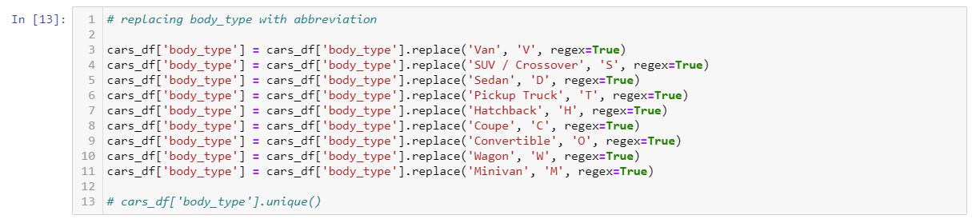
Data Cleaning, contd.
5. Fixing values:
Removing unnecessary and junk characters
Standardizing attributes values for colors and types using abbreviations
Notes:
Michele:
We substituted the names with their abbreviations for the body type of the used cars and grouped color categories together under one code name to reduce the size of our dataset and normalize the data

Slide 7
Data Cleaning, contd.
6. Filling null values:
Converting null values to a boolean value, False
Identifying missing cities and location details using SQL and adding those records to location tables
Adding the missing values (in the listing_color) by referring to the existing data related to that column (exterior_color)
Notes:
Identified the missing values or nulls by comparing the similar existing records. Data type conversion to define the measure columns. Unnecessary and Junk characters are removed from the columns.
Rows that contain many blank values for mandatory fields are removed.
part nd extracted a dataset for 1,048,575 used cars.

Slide 8
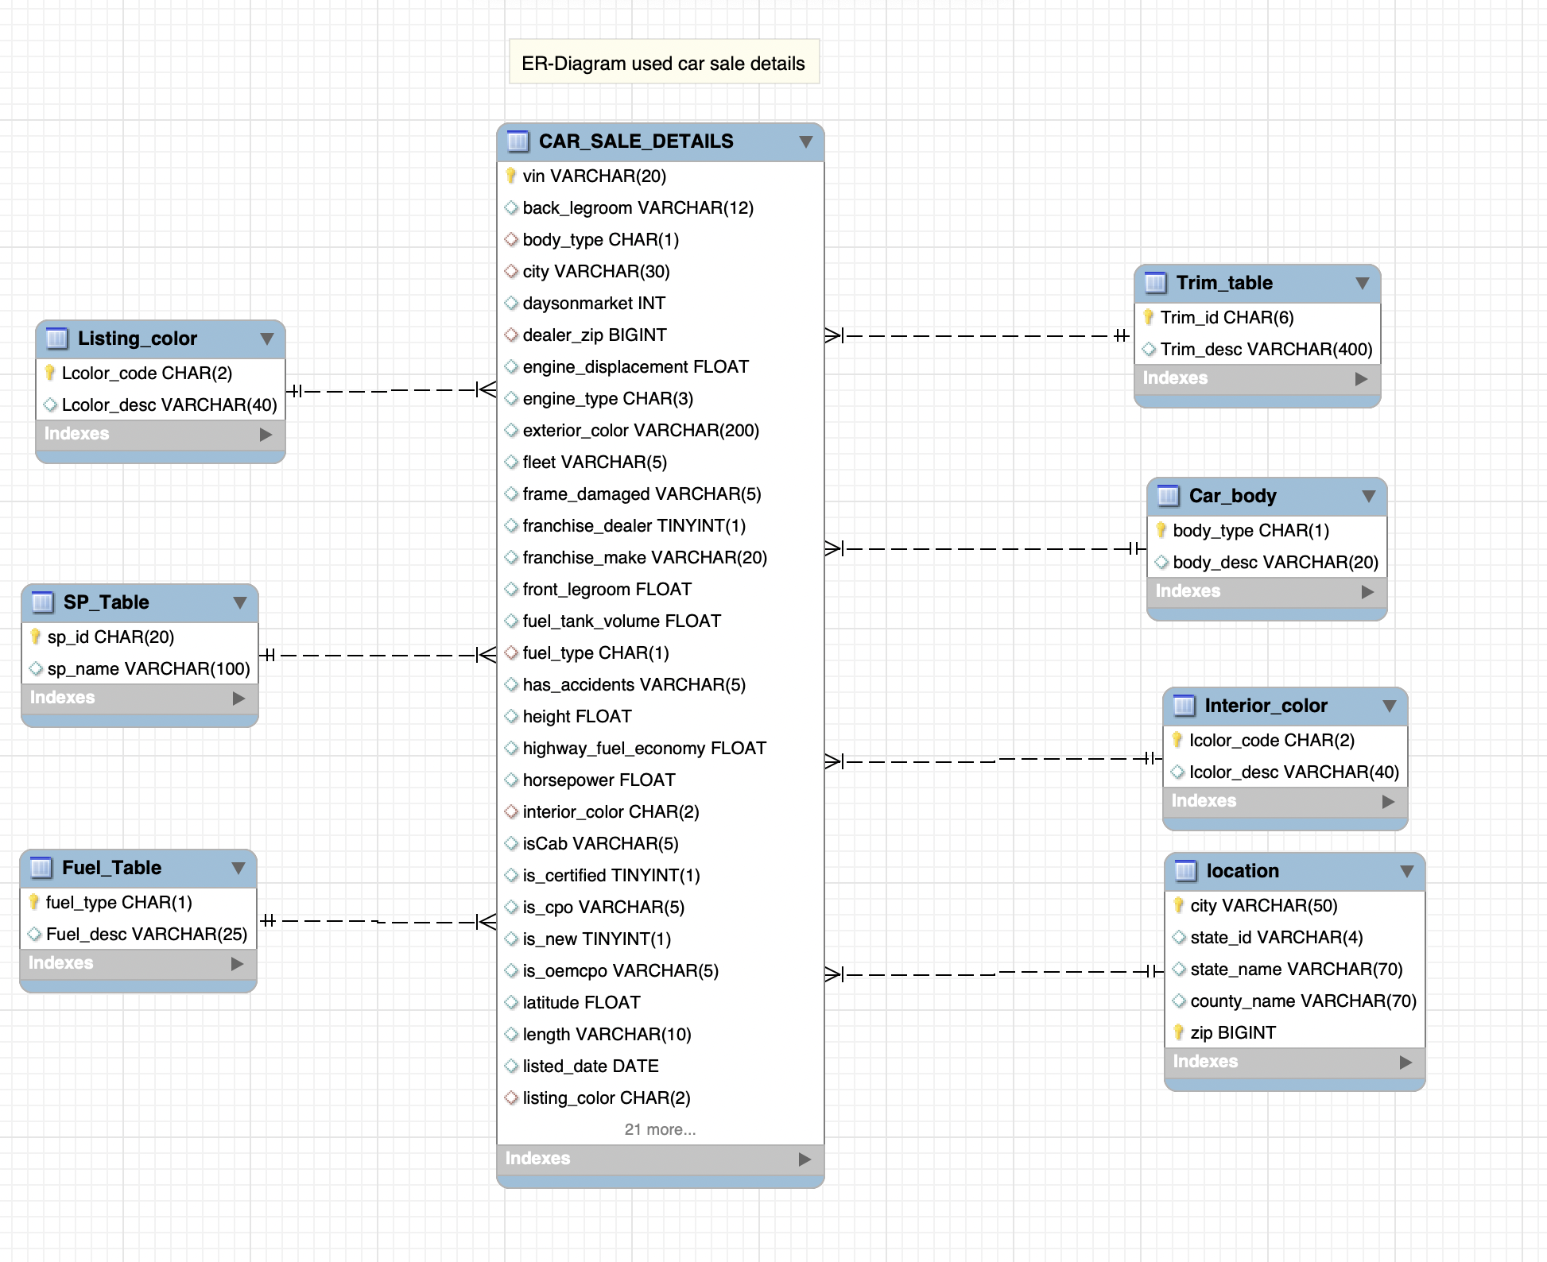
Schema - ER Diagram
Fact Table:
Car_sale_details
Dimension Tables:
Trim_table
Listing_color
Interior_color
Fuel_table
SP_table
Car_body
Location
Notes:
We normalized the data by splitting the data into facts and dimensions
As per the business requirement the Conceptual and logical data modeling structure are understood. By keeping this in mind we went ahead and designed the physical model using Mysql workbench.
The data model is star schema. The keys are existing in fact tables and the description of respective attributes are in dimensional table. Entity and relationship has been drawn.

Slide 9

Data Loading – AWS Cloud Platform
S3 Bucket
Cleaned data
Notes:
After cleaning the data, it has been stored in AWS S3 bucket. The data is uploaded as csv files, and each csv file corresponds to each table.

Slide 10
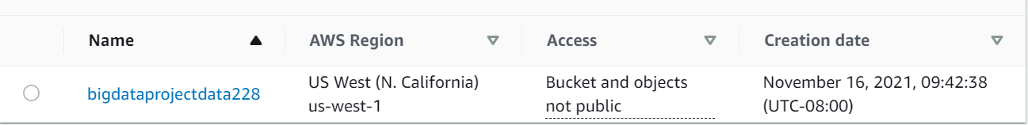
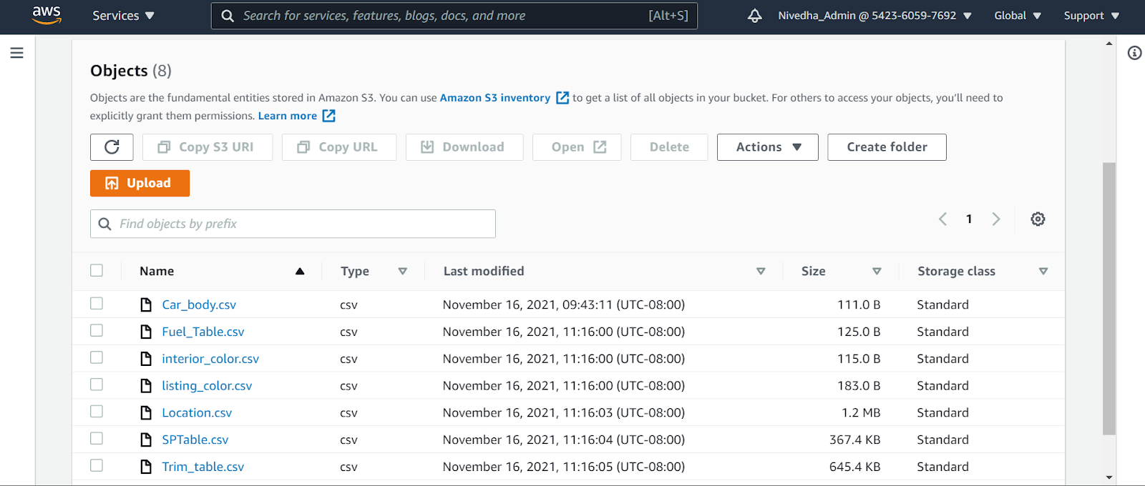
Data Loading – S3 Bucket

Slide 11




Data Transfer
S3
AWS RDS
Visualization
Visualization
S3
AWS Redshift
Notes:
We found that there are several ways to export the data from S3 bucket. In this project, we have experimented this step by two ways. Since our data model is relational, we used amazon relational database service (RDS). Here we transferred data from S3 bucket to RDS and then to visualization. And the second method we tried out is by transferring the data from S3 to redshift and then to visualization.

Slide 12
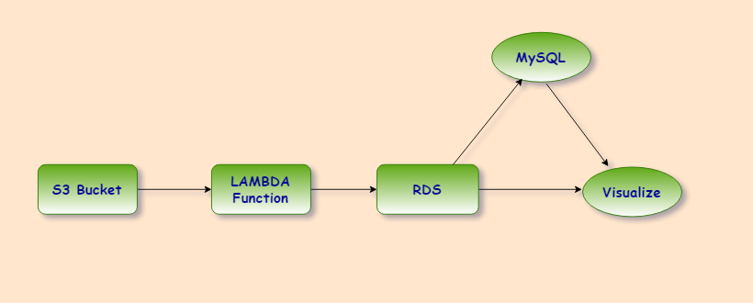
Data Transfer - RDS
Manipulate
&
Querying
Triggered
Notes:
The csv files are loaded to s3 bucket. The staging layer has been created using lambda. We have defined different lamda function and triggered. The data is stored in RDS.

Slide 13
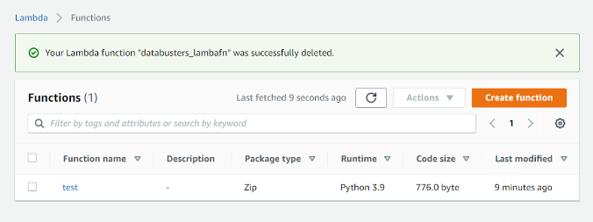
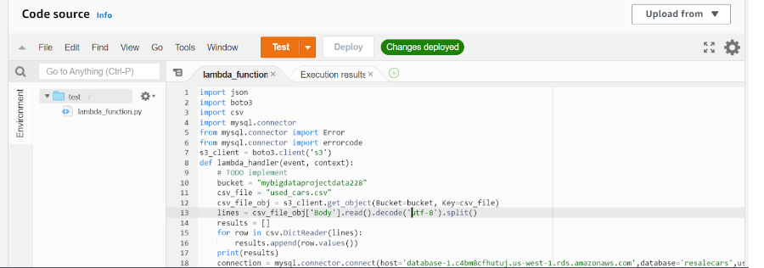
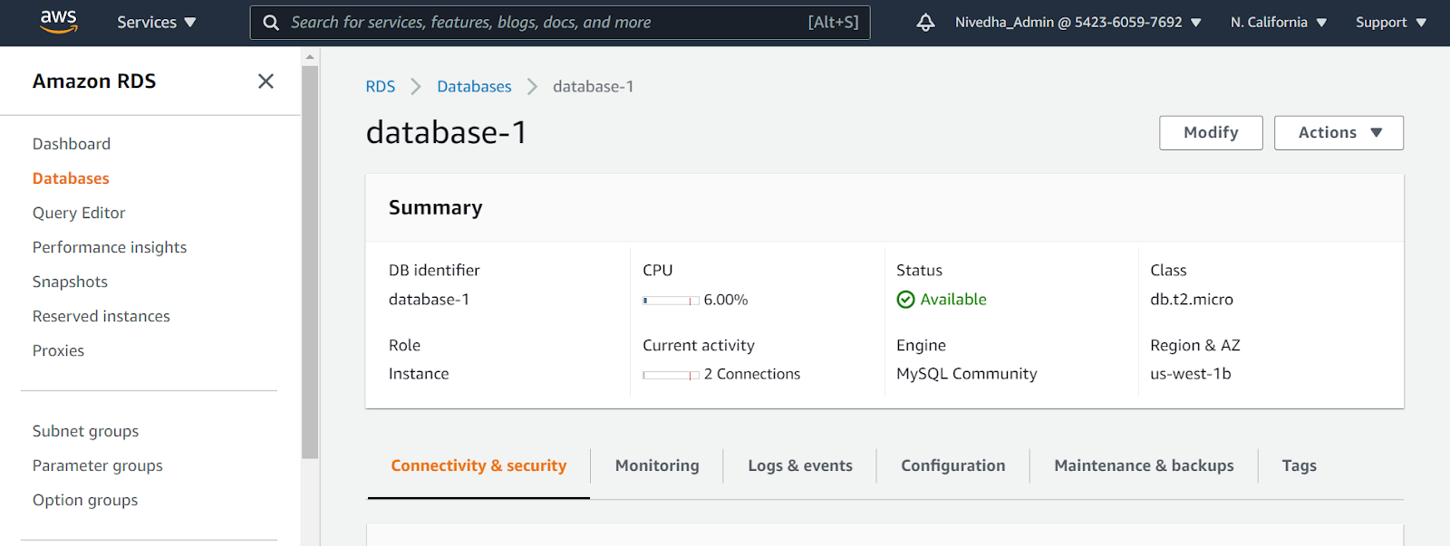
Data Transfer - RDS

Slide 14
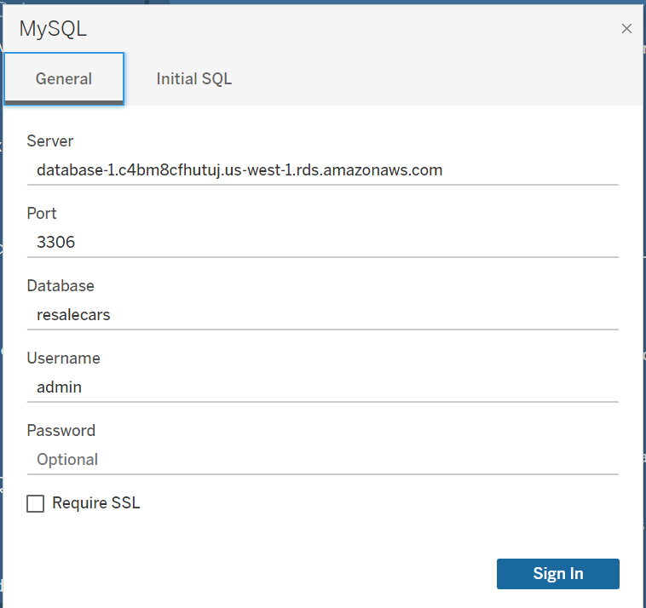
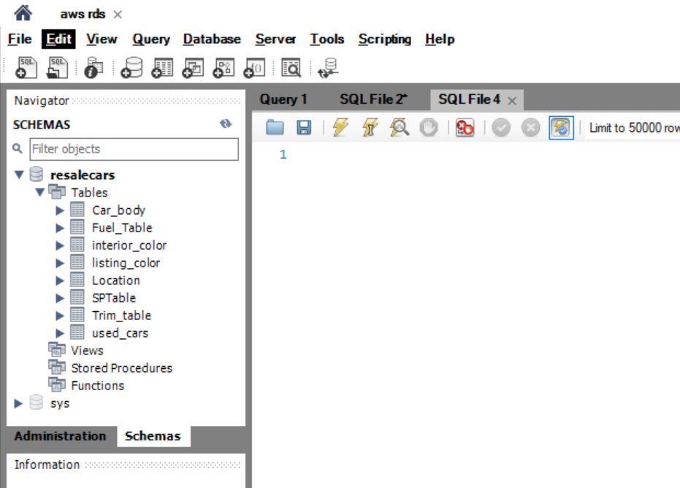
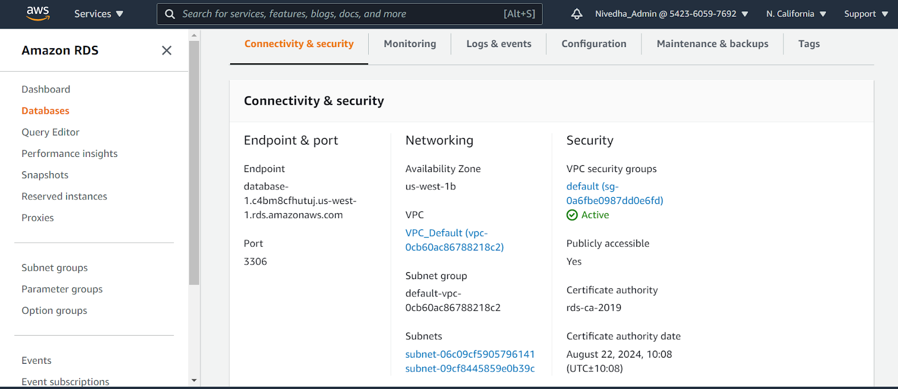
Data Transfer - RDS

Slide 15
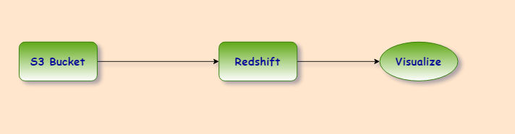
Data Transfer - Redshift
Copy Commands

Slide 16
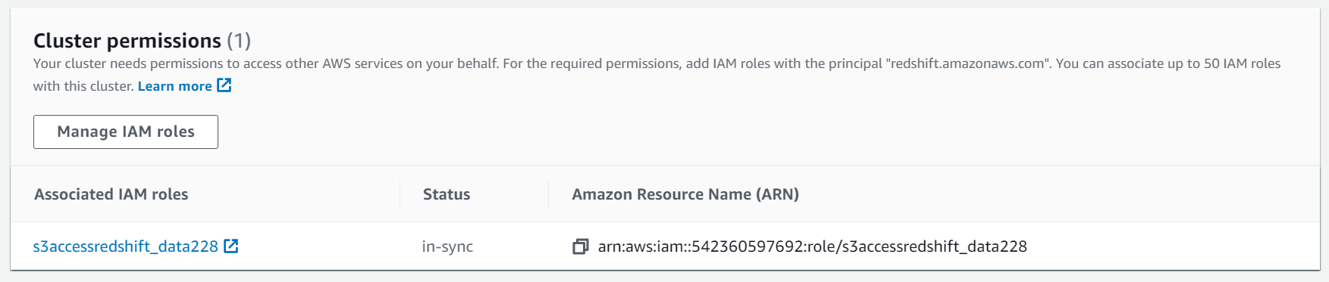
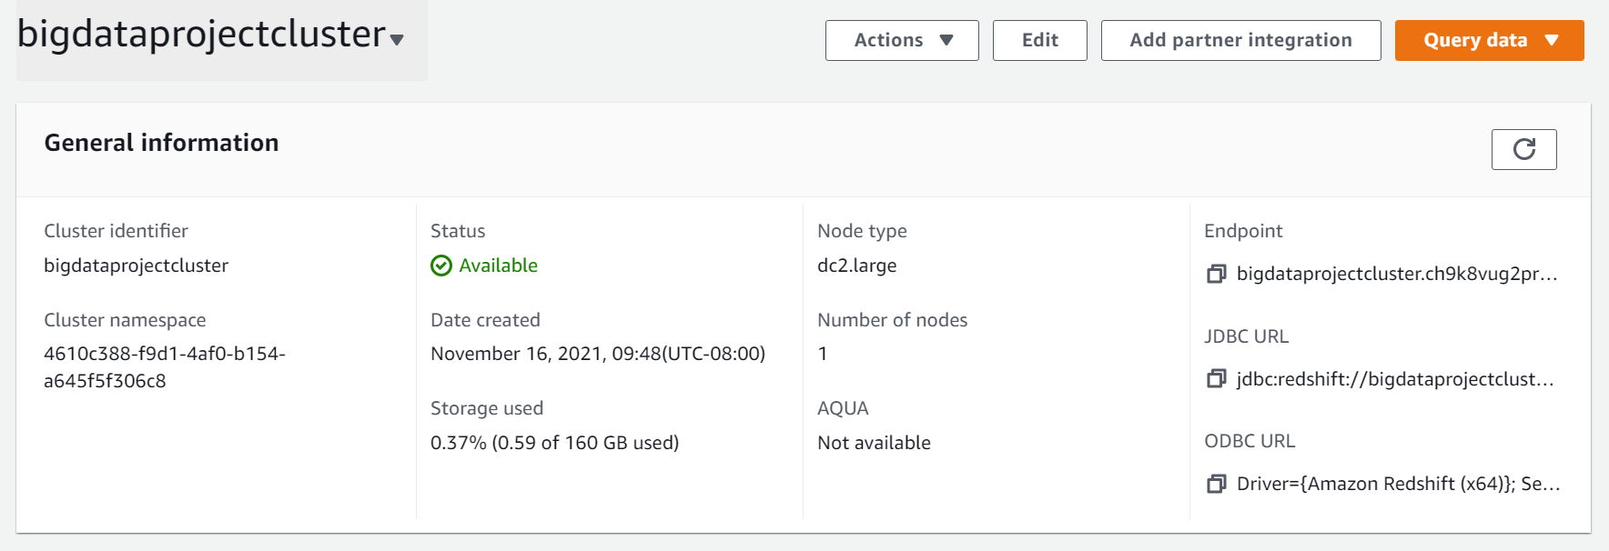
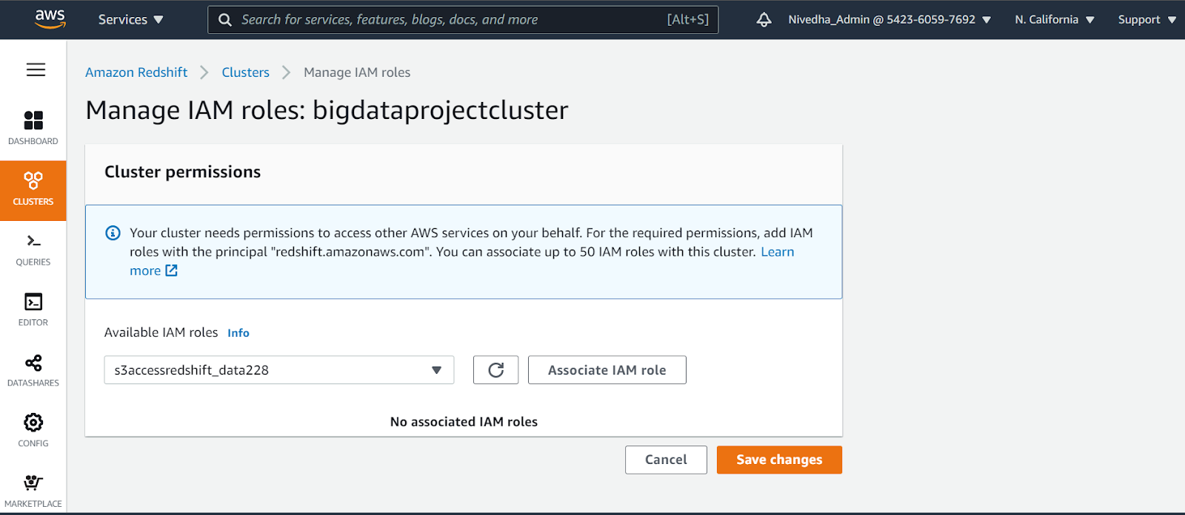
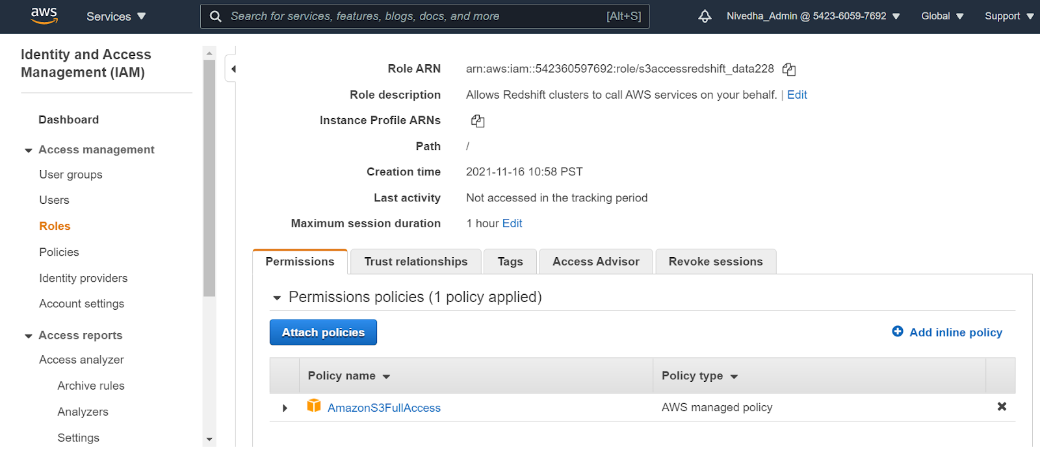
Data Warehousing - Redshift
Notes:
Once the data is loaded to the data warehouse, we are using different tools to connect to the database. The tools like Mysql workbench will help in fetching the data to understand the data. This helps to do aggregation, importance of each column and key values that required for the analysis.

Slide 17
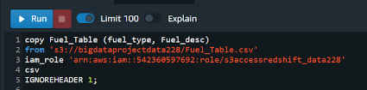
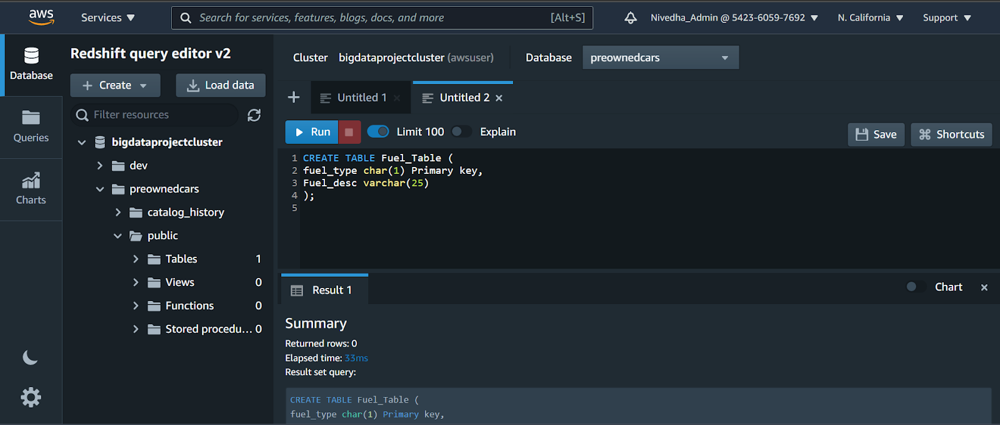
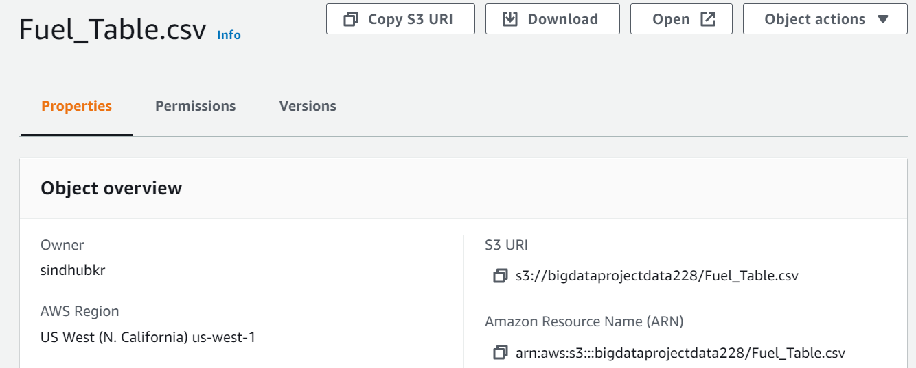
Data Warehousing - Redshift
Notes:
Once the data is loaded to the data warehouse, we are using different tools to connect to the database. The tools like Mysql workbench will help in fetching the data to understand the data. This helps to do aggregation, importance of each column and key values that required for the analysis.

Slide 18
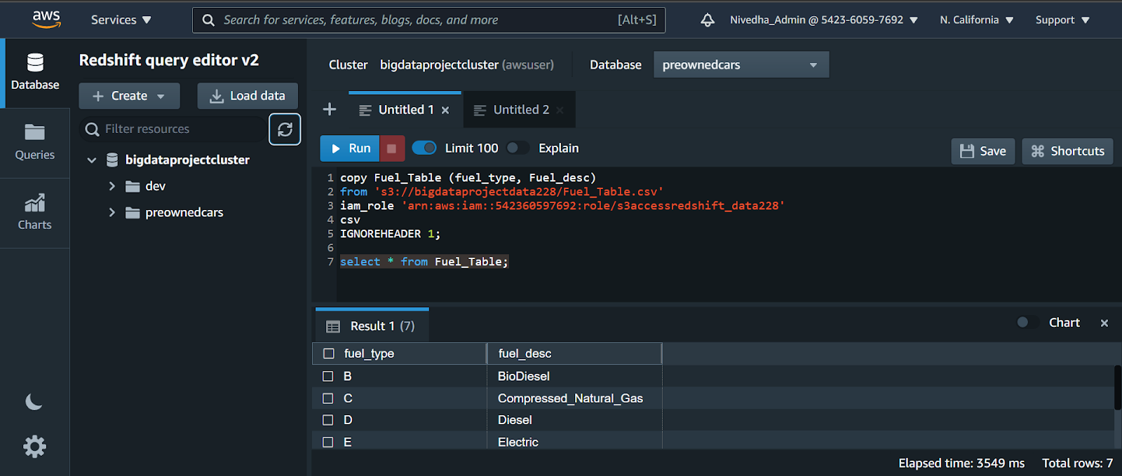
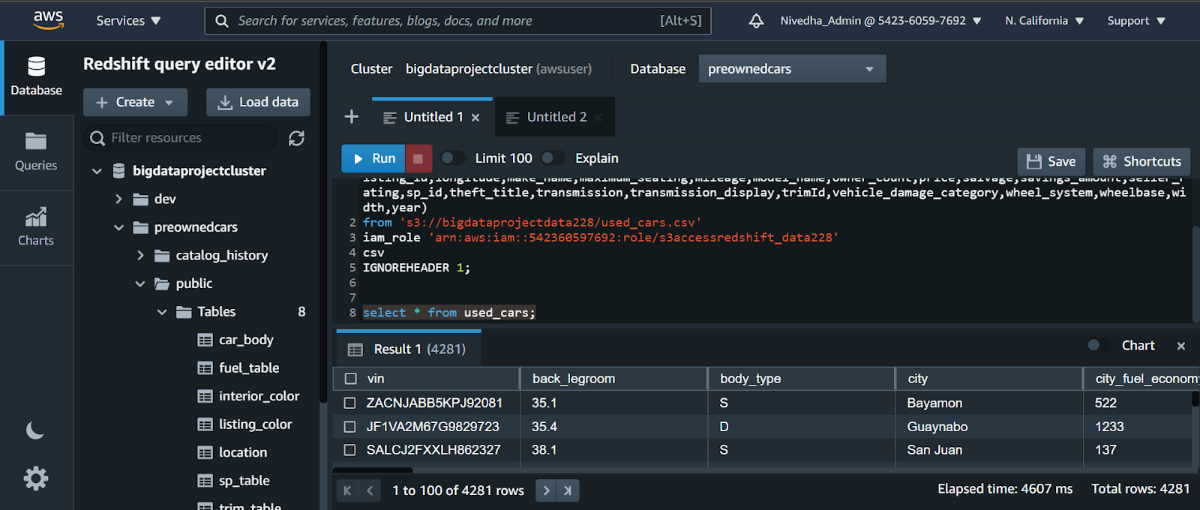
Data Warehousing - Redshift

Slide 19


Data Visualization
Two tools were used for data visualization:
Tableau : Connecting Tableau application to Amazon Redshift.
Python : Connecting python to amazon Redshift cluster.
Notes:
Once the data was loaded and stored on the cloud, we have connected Tableau and python tool for data mining and data visualization. Tableau helps in plotting multiple graphs, charts and dashboards. Python helps in understanding data at granular level along with multiple graphs.

Slide 20
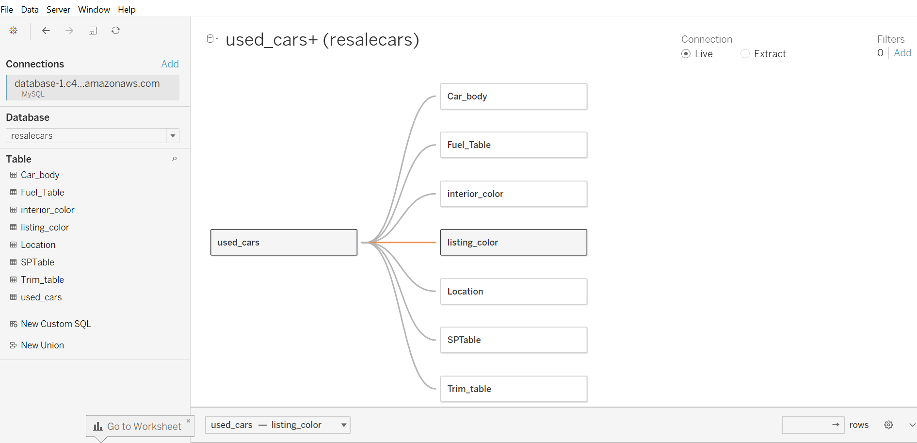
Data Visualization - Tableau Connectivity
Tableau connectivity to database
Notes:
Setups are done to connect Tableau tool and pulled out all the required tables ( facts and dimensions ). The tables are joined to plot and view the insight of data.

Slide 21
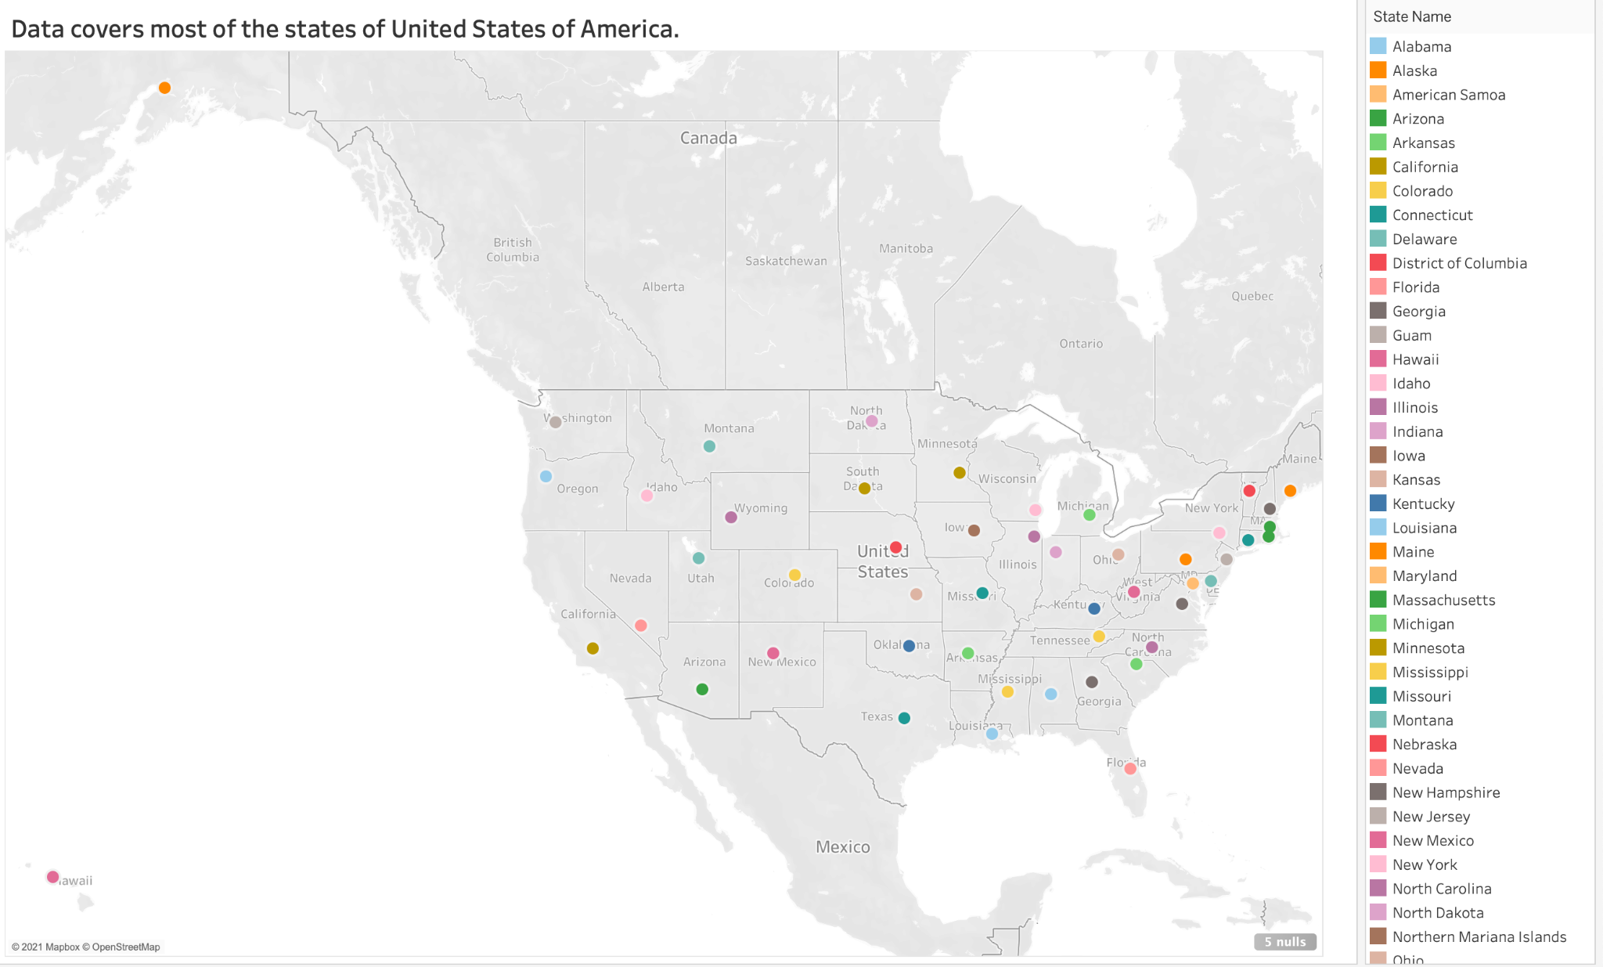
Data Visualization - Tableau
Notes:
The geographical view of the data explains the data is covered from all the different stats of USA including Alaska and Hawaii islands. This clearly shows that data contains multiple cities and data is purely multidimensional.

Slide 22
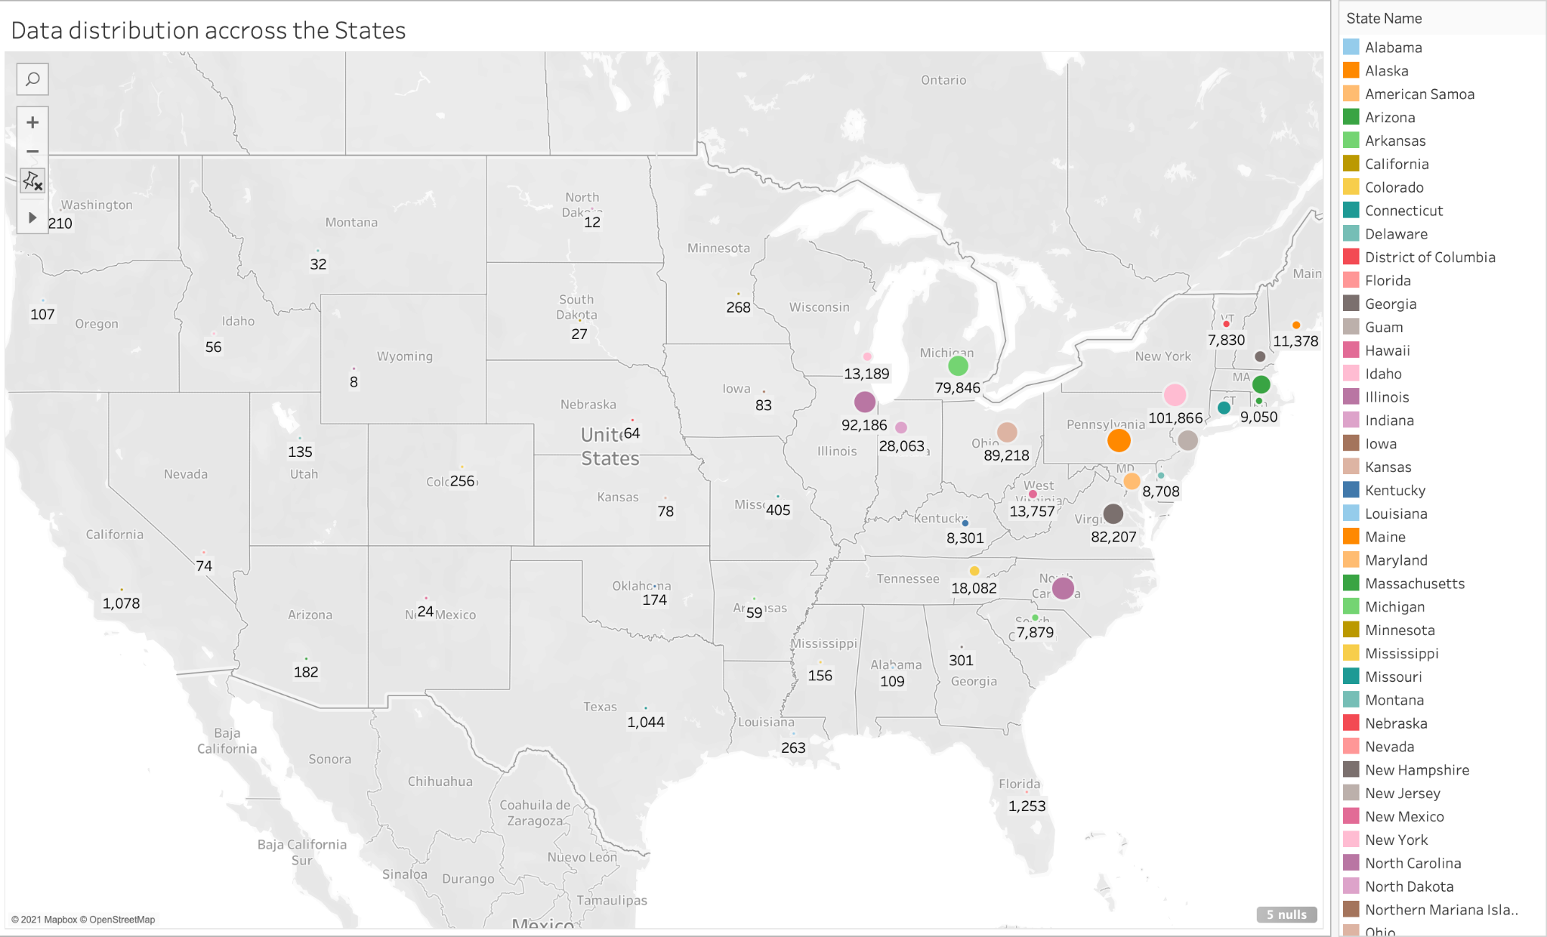
Data Visualization - Tableau
Most of the pre-owned cars on the market were located on the East Coast.
The top 3 states are:
Pennsylvania
New York
North Carolina
Notes:
This clearly explains how the population is contributing the number of cars in different states. More number of cars falling into eastern region of USA and contributing to more demands.

Slide 23
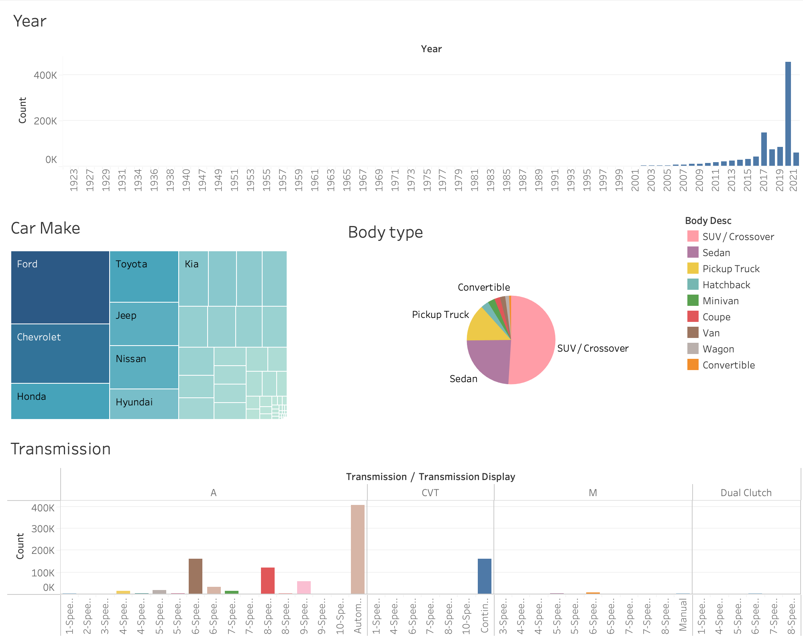
Data Visualization - Tableau
Pre owned cars were on sale from 1923 to 2021
Highest number of used cars on the market are between 2018 and 2020
The highest number of used cars on the market throughout the years:
are of the brand Ford
are of type SUV/Crossover
have an Automatic Transmission
Notes:
The history of the data is from past 100 years and signifies the demands of the car since then. Customers are looking for used cars but they were focusing on specific model, color and transmission type. The dashboard shows Ford has been leading the market.

Slide 24
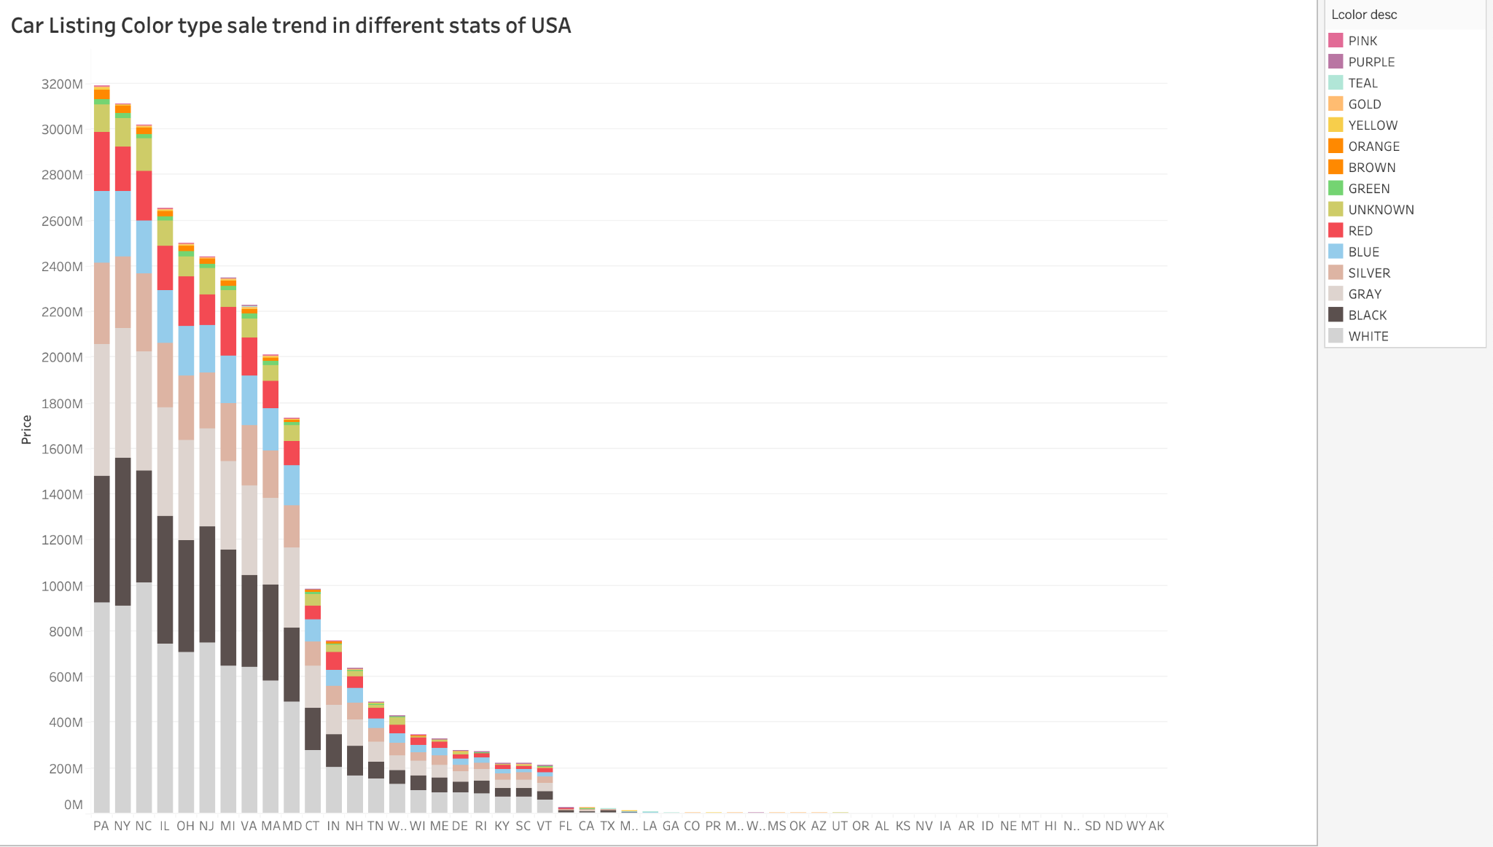
Data Visualization- Tableau
In the Top 3 states, the Top 3 colors are:
White
Black
Gray
Notes:
Irrespective of number of car available in different states either there is a great demand or less, the white and black color cars stand in the top positions.
The top colors of used cars on the market are also the same in the rest of the states.

Slide 25
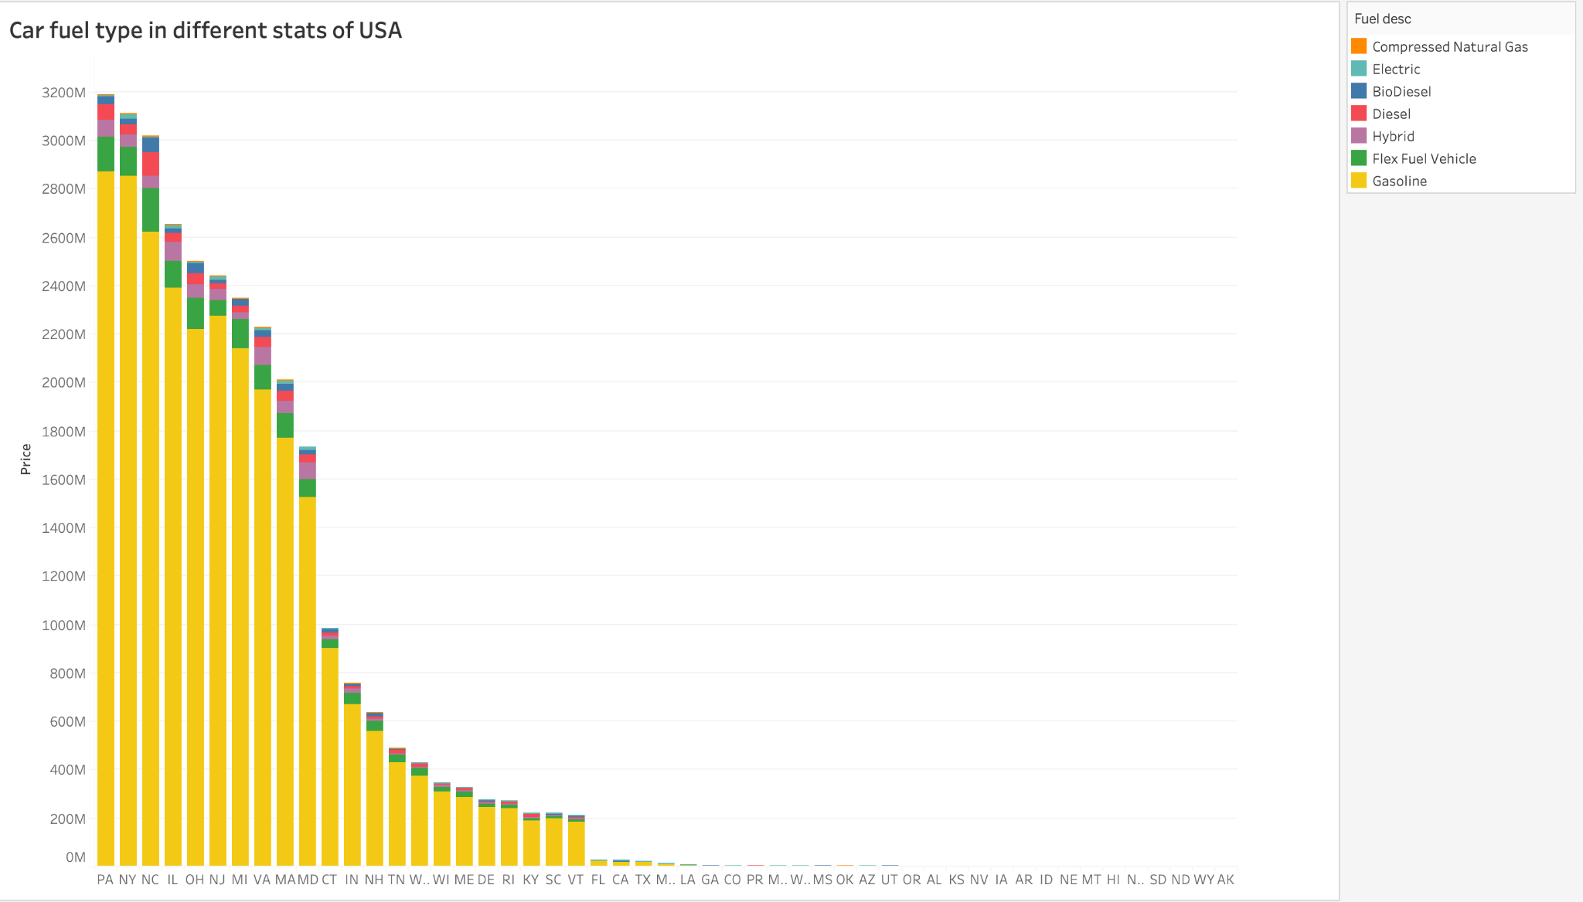
Data Visualization - Tableau
The vast majority of the pre-owned cars for sale throughout the years use Gasoline
Notes:
Gasoline cars are more demanding and valuable. Most of the pre-owned cars are falling into Gasoline.

Slide 26
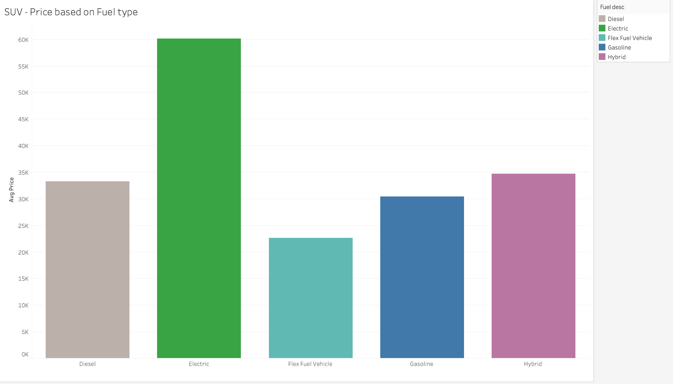
Data Visualization - Tableau
The price of the vehicle is also dependent on the fuel type
Car price for fuel type in descending order.
Electric
Hybrid
Diesel
Gasoline
Flex Fuel Vehicle
Notes:
Gasoline cars are more demanding and valuable. Most of the pre-owned cars are falling into Gasoline.

Slide 27
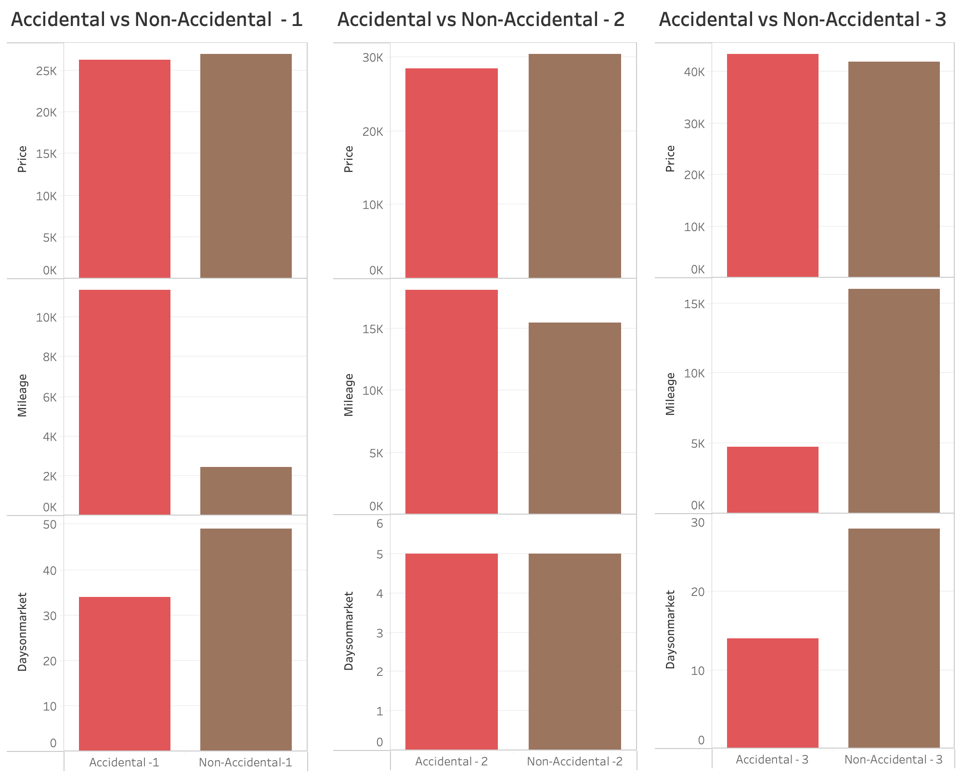
Data Visualization - Tableau
The cars compared:
have the same manufacturer, engine and body type
were produced the same year
were posted for sale in the same location
The price of the vehicle depends on the factors below:
Miles covered
Accident/damage.
Notes:
The most important factor affecting the price of the used cars is the number of miles covered with that car. Generally, the listing price of the car will be reduced if the car was involved in an accident.
It seems that other factors determined how long the used cars stayed on the market before being sold.

Slide 28
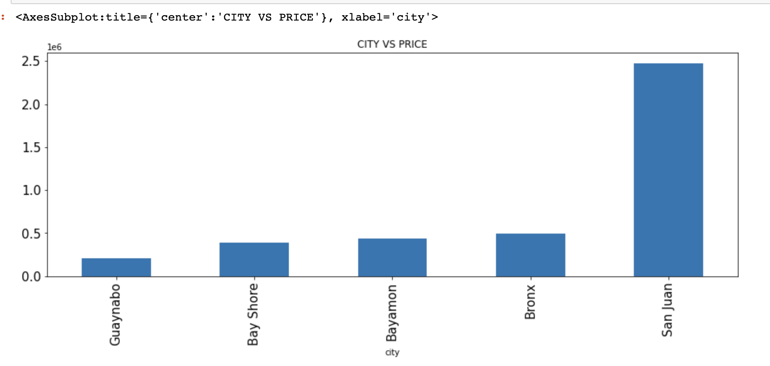
Data Visualization - Python
The price of the car depends on the location and city.
Top 2 cities:
San Juan, Puerto Rico
Bronx, New York
Notes:
The price of the car is tagged to the city and its location.
We have noticed the top states wrt the population in tableau visualization ,here are the top cities where the price of the used-cars are high.

Slide 29
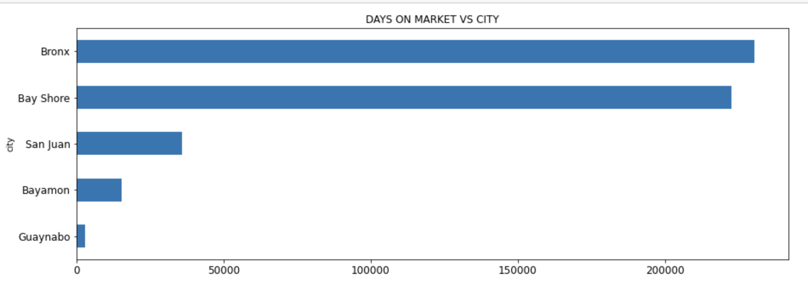
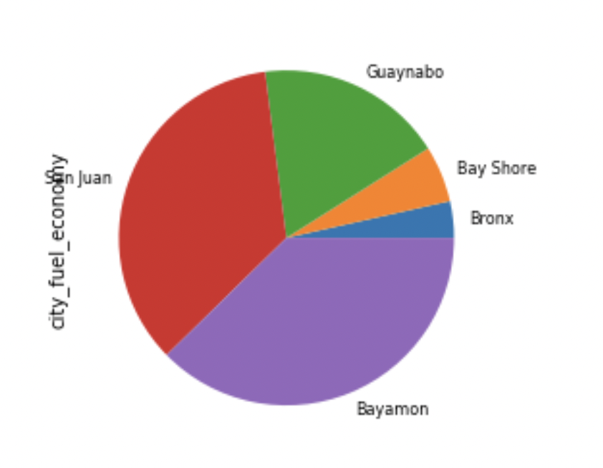
Data Visualization - Python
Effect of Days on market on the city fuel economy:
Notes:
Cities like Bronx and Bayshore has vehicles which stay on market for a long time .
In the pie chart we can notice that the fuel economy for such cities is less compared to others.

Slide 30
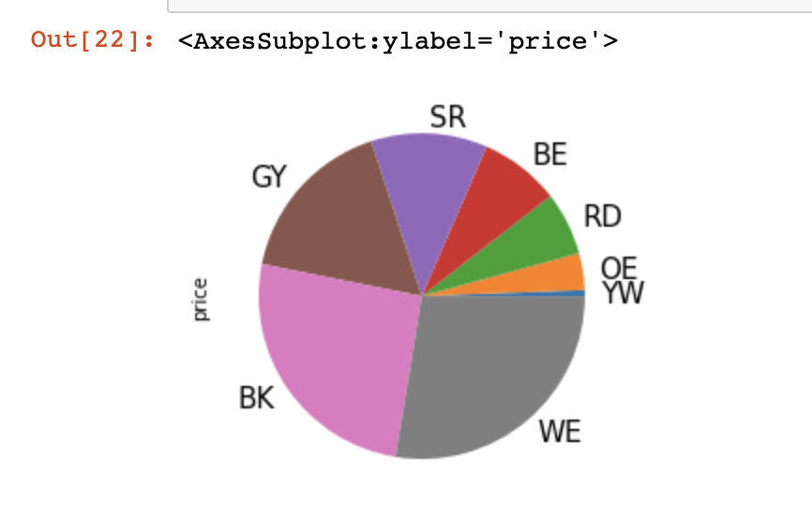
Data visualization - Python
Color on Demand
White
Black
Notes:
We have noticed that White and Black are most demanding exterior colors in tableau ,here we can see that both white and black colour has more price compared to others.
This graphs helps us understand that price depends on colour of the vehicle.

Slide 31
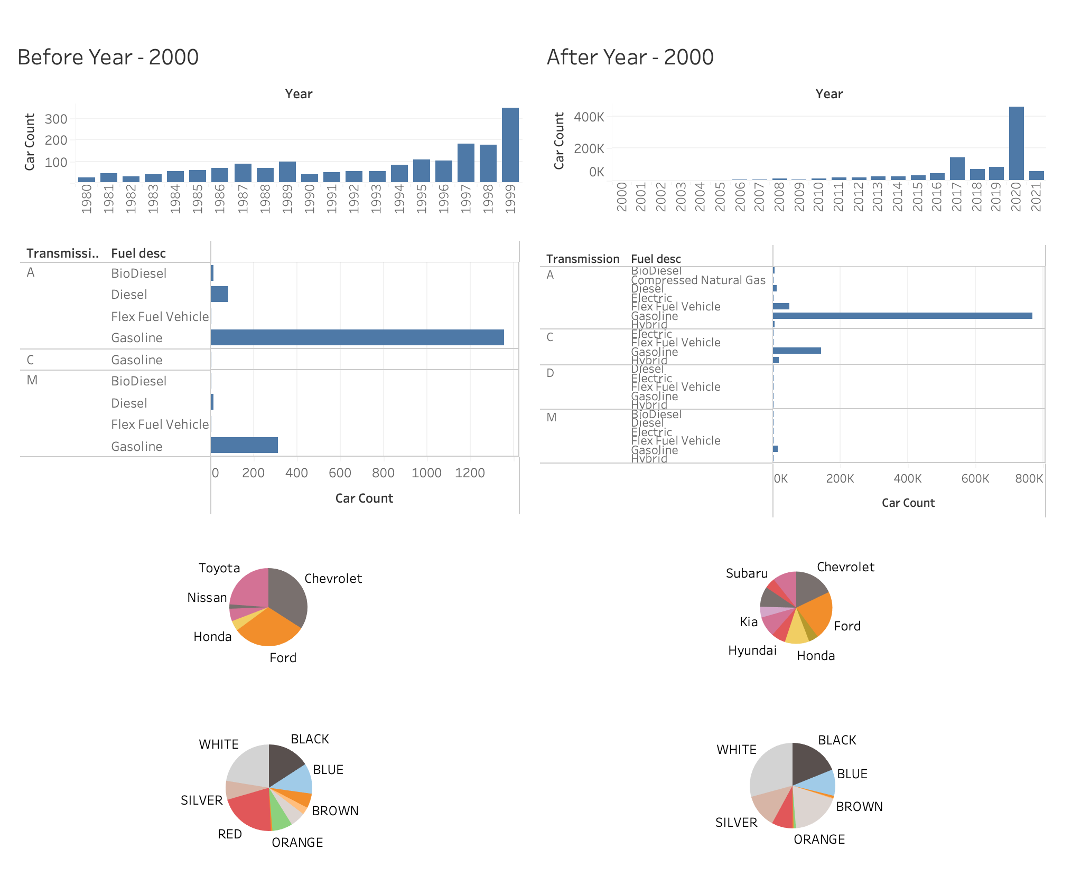
Data Visualization - Tableau
Comparative dashboard of used cars on the market up until 2000 and after 2000
Key Insights:
Used cars on the US market exponentially increased
Smaller share for market leaders
White and black are popular colors
Notes:
The number of used cars on the US market exponentially increased in recent years after 2000
Market Leaders were Ford, Chevrolet and Toyota. The market is more diverse now.
The proportion white and black cars is almost the same. Red has decreased while silver/grey has increased .
Ford being the top leader made sense, since the first cars accessible to the american public a couple of decades before 1923 were Fords.

Slide 32
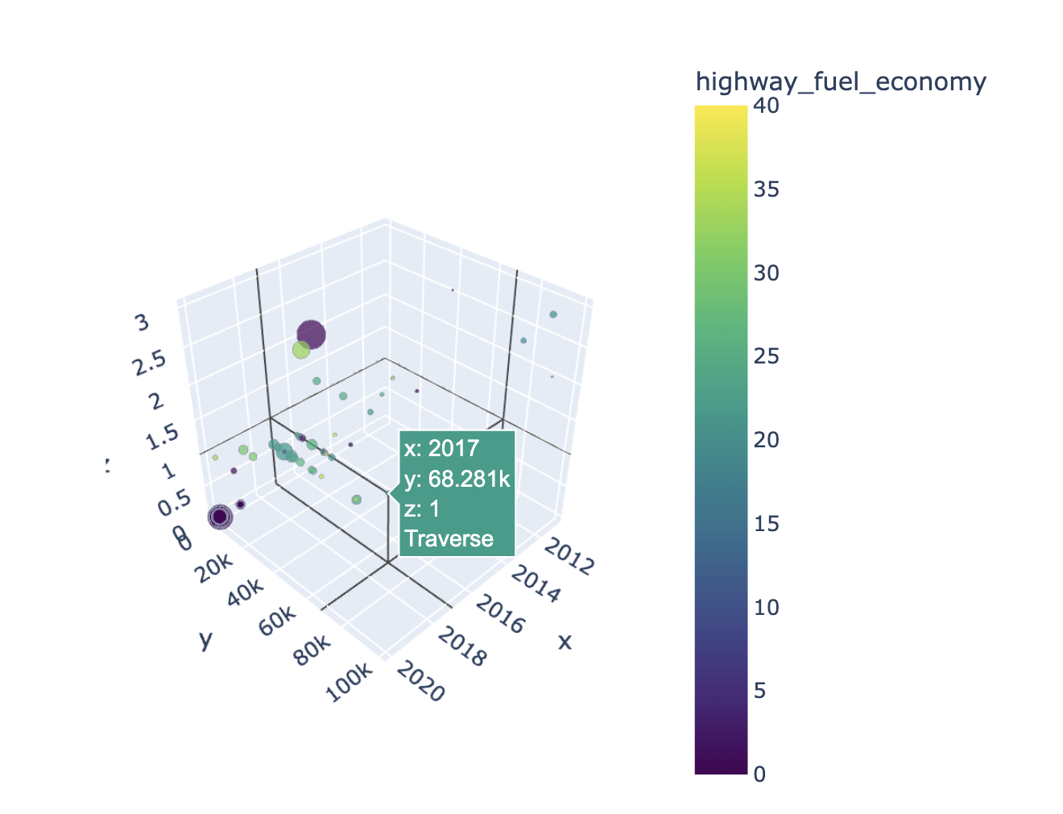
Data Visualization - Python
3D graph with Overall
dataset information
Notes:
This graph gives total insights of the dataset
The x axis is the year,y axis tells about the mileage (distance travelled by the car) ,z axis has the count of owners.
Size of the scatter plot tells us about the price and colour tells about the economy .
Here is an example in year 2017 , show the graph

Slide 33
Web Application implementation in
AWS

Slide 34
Step 1
Step 2
Step 3
Step 4
Create the S3 buckets for domain and subdomain
Load the code related to the website and give static website permissions
Testing
Register for a domain

Slide 35
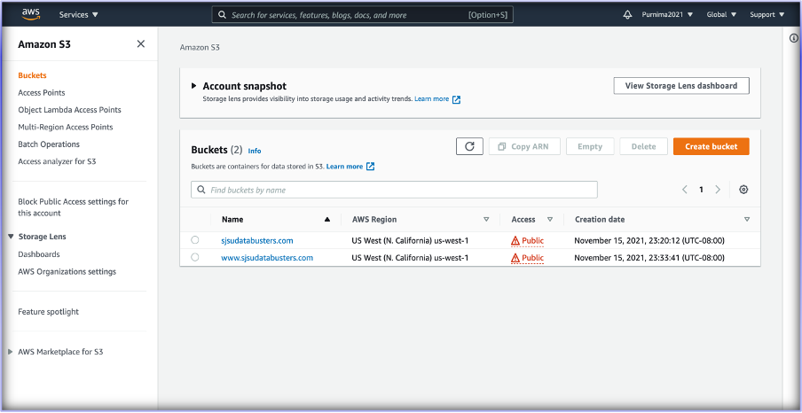
Domain name- sjsudatabusters
Buckets created :
sjsudatabusters.com
www.sjsudatabusters.com

Slide 36
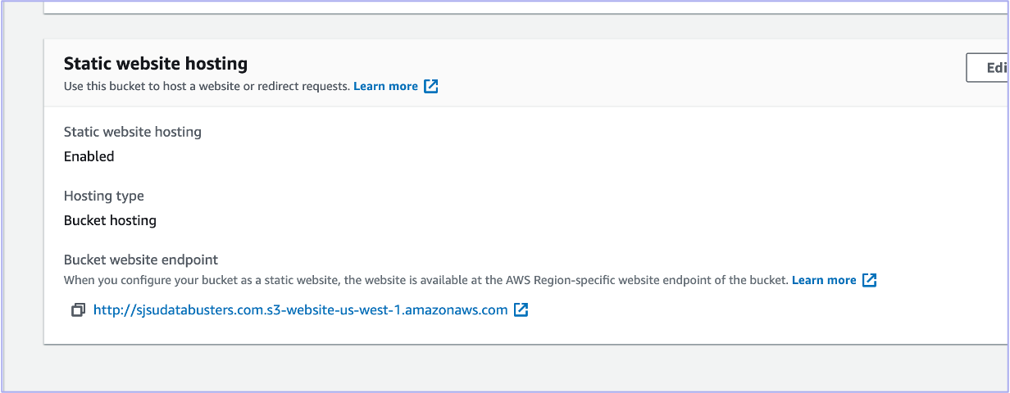
http://sjsudatabusters.com.s3-website-us-west-1.amazonaws.com

Slide 37
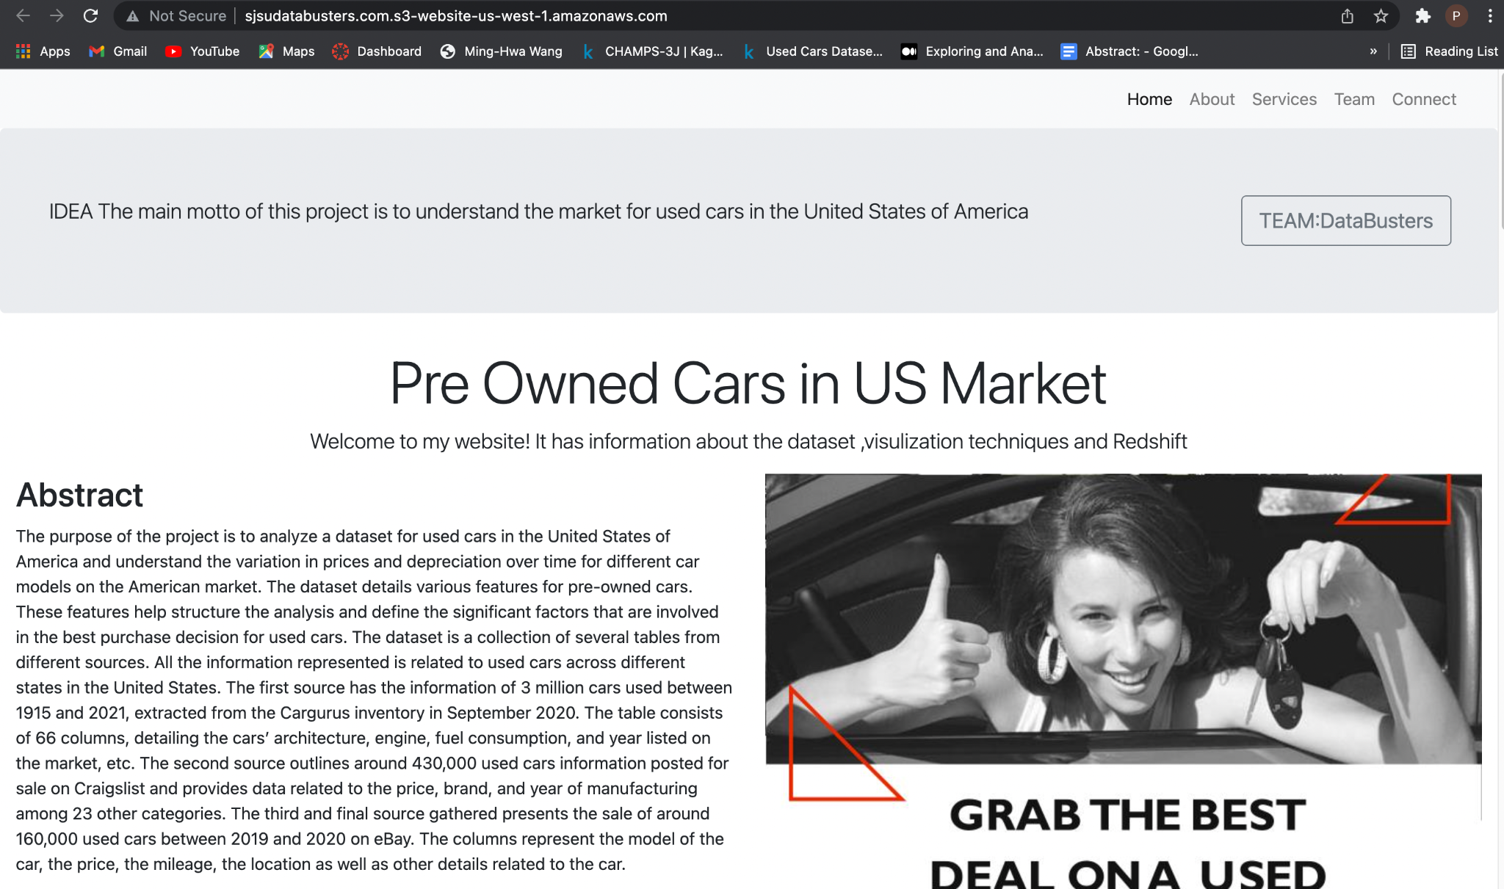
PRE OWNED CARS WEBSITE

Slide 38
Conclusion
The price of the car depends on the below main factors.
Milage
Accident
Make name
Model
Location
Exterior Color
Number of days in the market
Fuel type

Slide 39

Thank you :)

Slide 40
References
https://www.kaggle.com/ananaymital/us-used-cars-dataset?select=used_cars_data.csv
https://www.kaggle.com/austinreese/craigslist-carstrucks-data
https://www.kaggle.com/tsaustin/us-used-car-sales-data
https://www.consumerreports.org/buying-a-car/car-buying-guide/
https://cars.usnews.com/cars-trucks/how-to-buy-a-used-car

